Slide 1
Models and cases of social entrepreneurship (SE) and strategic planning used for solving environmental problems in the contemporary Industry 4.0 environment
Professor Dr Ivan Mihajlovic
University of Belgrade, Technical faculty in Bor, Engineering Management Department
imihajlovic@tfbor.bg.ac.rs www.menadzment.tfbor.bg.ac.rs
Vojske Jugoslavije 12, 19210 Bor, Serbia

Slide 2
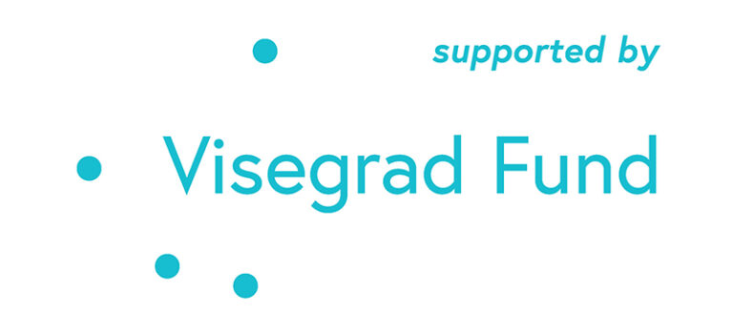
Scope:
Introducing the Strategic Management tools
Basic concept of CSR and 5 important dimensions
Social entrepreneurship – basic models and examples of world practice
Case Study : Using the strategic management tools in selected case study
Acknowledgement: This study is resulting from the international project: "Possibilities and barriers for Industry 4.0 implementation in SMEs in V4 countries and Serbia", which was financed through International Visegrad Fund, with the reference number: 22110036.

Slide 3
Basic concept of CSR and its
5 important dimensions

Slide 4
Corporate Social Responsibility CSR
‘CSR is about how companies manage the business processes to produce an overall positive impact on society.’ (Mallen Baker, a writer, speaker and strategic advisor on CSR, www.mallenbaker.net )
‘Corporate social responsibility is the commitment of businesses to contribute to sustainable economic development by working with employees, their families, the local community and society at large to improve their lives in ways that are good for business and for development.’ (International Finance Corporation)
‘CSR is a concept whereby companies integrate social and environmental concerns in their business operations and in their interaction with their stakeholders on a voluntary basis.’ (European Commission)

Slide 5
Corporate Social Responsibility CSR
Although there are so many definitions, according to Alexander Dahlsrud of the Norwegian University of Science and Technology almost all of them involve five ‘dimensions’ of CSR, as shown in Table:
(Dahlsrud, A. (2006) How corporate social responsibility is defined: an analysis of 37 definitions, Corporate Social Responsibility and Environmental Management, vol. 12, no. 2)

Slide 6
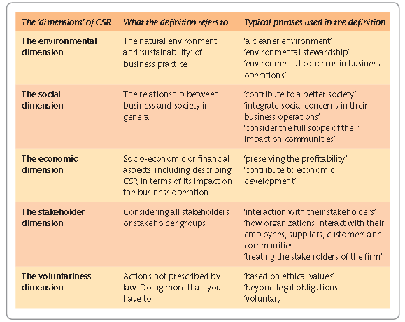
The five dimensions of CSR and
example phrases
Triple bottom line

Slide 7
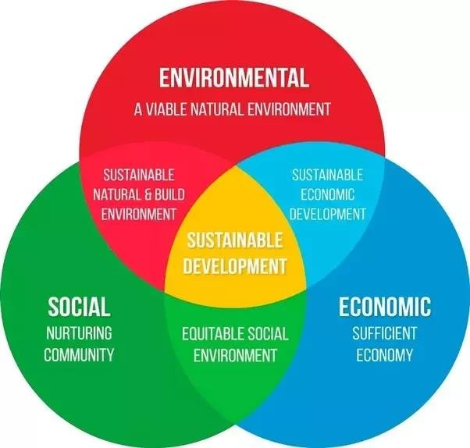

Slide 8
Social entrepreneurship – basic models and examples of world’s practice

Slide 9
Social Entrepreneurship SE
E + CSR = CSE (SE)
Dealing with worlds challenges using entrepreneurship knowledge and skillls
Differences compared to CSR ?

Slide 10
From CSR to SE

Slide 11
Glossary
Incremental Innovation. This consists of small, yet meaningful improvements in your products, services, and other ways in which you do business.
Breakthrough Innovation. This is a meaningful change in the way you do business that gives consumers something demonstrably new (beyond "new and improved").
Transformational Innovation. This is usually (but not always) the introduction of a technology that creates a new industry and transforms the way we live and work. This kind of innovation often eliminates existing industries or, at a minimum, totally transforms them.

Slide 12
Entrepreneurs/Social Entrepreneurs

Slide 13
Entrepreneurs/Social Entrepreneurs

Slide 14
Models of SE
Model of entrepreneurial support,
Model of market mediation,
Employment model,
Direct participation fee for services model,
Subvention model.

Slide 15
Model of entrepreneurial support
Example: ProMujer.com Bolivia

Slide 16
Model of market mediation
Example: Marketing Cooperative Blue Stone – Philippines
- Maunt Pintubo, 1990.

Slide 17
Employment model
Example: “Kosmos” Print House, BGD, Serbia
Employing hard to employ individuals
Visually challenged (blind)
35/67 Emp.

Slide 18
Direct participation fee for services model
Example: BookShare.org
-Less than 5% books available to visually challenged people
Audio and Braille format
Benetech initiative (Silicon Wally) http://www.benetech.org/
50$ registration + 25$/year participation fee
More than 100.000 students

Slide 19
Subvention model
Example: Toms Shoes http://www.toms.com/

Slide 20
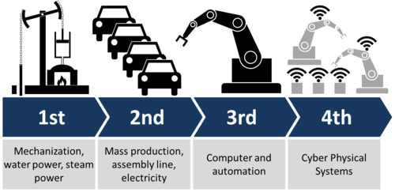
Industry 4.0 and the SE/CSR
Modern technologies based on Industry4.0 change the business environment, especially in SMEs.
This opens a new field in research and possibilities for continuing and strengthening academic collaboration among partner institutions in Visegrad countries (V4) and Serbia which the focus would be on acceptance of Industry4.0 concepts in SMEs.
Source of Ilustration: https://www.psu.edu/news/research/story/manufacturing-vp-discuss-internet-manufacturing/

Slide 21
Case Study : Potential to use CSR and SE in solving one of environmental issues in the vicinity of Bor company

Slide 22
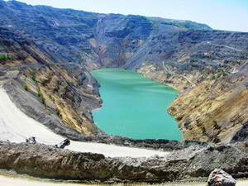
Case Study
POMETON TIR DOO:
Mining waste water purification and copper production
Open pit and underground mining
Lakes of waste water
Sulfur from the ore,
Reacts with H₂O from
The atmosphere
Dissolved copper in
Small quantities

Slide 23
Case Study

Slide 24
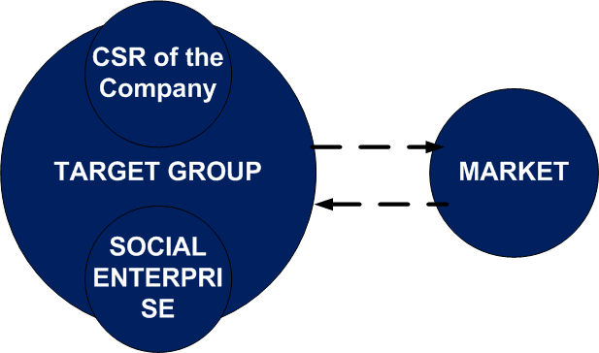
Case Study
Started as the research project
Growth in pilot plant
Now a facility which produces the copper powder in considerable amounts

Slide 25
Sustainable Development

Slide 26
Question 1
The state of CSR and SE practices in companies in Hungary
The examples of SE in Hungary (chose one example of the real company of SME / or imagine one and present it with the model / including Target Group, Social Enterprise (SE) and the Market)

Slide 27
Strategic Management
The concept of strategy is borrowed from military terminology, and has been used in the literature in the field of economics and management since the mid-1950s.
In a broader sense, strategy is a fundamental management decision that includes goals, policies and ways of their implementation in economic practice.
The narrower understanding treats strategy as a business decision which defines the basic ways of achieving the company's goals.
Therefore, the strategy, represents the allocation of resources to alternative projects and an pathaway to overcome the lack of almost always limited resources.

Slide 28
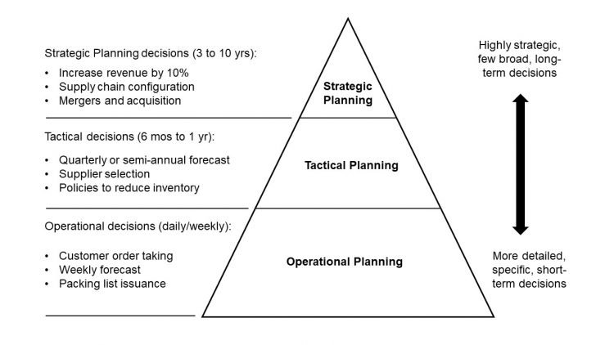
Strategic Management
We define strategic management as a process that includes goal setting, strategic analysis, strategic decision making, strategy design and implementation, and implementation control.
In the literature, some authors summarize the activities of strategic management in the abbreviation MOST (mission, objectives, strategy, tactics)

Slide 29
Strategic Analysis Tool / SWOT
What Is SWOT Analysis?
SWOT (strengths, weaknesses, opportunities, and threats) analysis is a framework used to evaluate a company's competitive position and to develop strategic planning.
SWOT analysis assesses internal and external factors, as well as current and future potential.

Slide 30
Strategic Analysis Tool / SWOT
SWOT Table
Strengths 1. What is our competitive advantage? 2. What resources do we have? 3. What products are performing well? | Weaknesses 1. Where can we improve? 2. What products are underperforming? 3. Where are we lacking resources?
Threats 1. What new regulations threaten operations? 2. What do our competitors do well? 3. What consumer trends threaten business? | Opportunities 1. What technology can we use to improve operations? 2. Can we expand our core operations? 3. What new market segments can we explore?

Slide 31
TOWS matrix
The SWOT matrix is ​​a diagnostic tool for the overall picture of the organization which identifies strategic options in relation to the internal analysis of the organization and the analysis of the external environment.
In order to relate the results of the analysis of the external environment to the internal capabilities of the organization, Weihrich (Weihrich, 1982) developed the TOWS matrix in 1982, which deals with the relationship between the internal and external environment.
TOWS looks at the interactivity of future factors - opportunities (O-Opportunities) and threats (T-Threats) that determine future events in relation to the factors of the present: strengths (S-Strenghts) and weaknesses (W-Weaknesses).

Slide 32
TOWS matrix
There are four groups of possible strategic actions:
maximizing strength in order to maximize environmental opportunities (SO e.g. maxi-maxi strategy);
minimizing weaknesses to seize opportunities (WO e.g. mini-maxi strategies);
maximizing strenghts in order to minimize threats (ST e.g. maxi-mini strategy);
minimizing weaknesses and minimizing threats (WT e.g. mini-mini strategy).

Slide 33
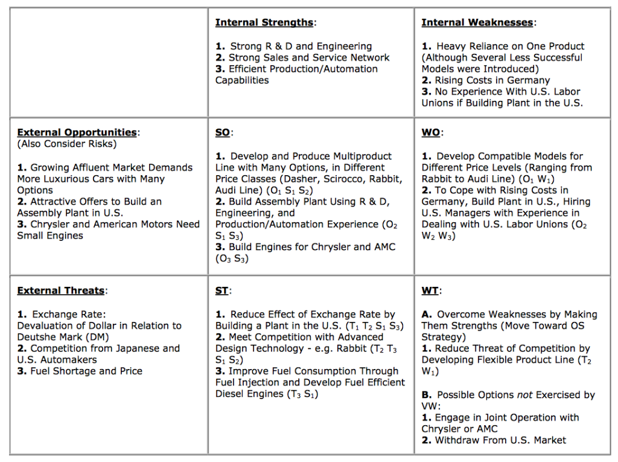

Slide 34
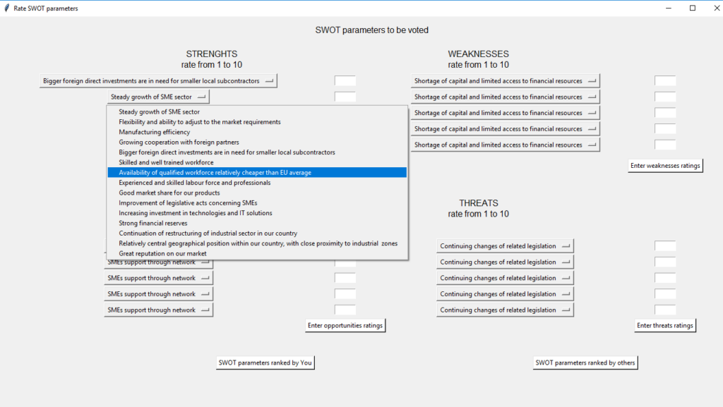
Project results: Identifying the needs, possibilities, and barriers for digitalization and Industry 4.0 concepts implementation in the SMEs in V4 and Serbia
Source: https://mksm.sjm06.com/visegrad-project-2021-possibilities-and-barriers-for-industry-4-0-implementation-in-smes-in-v4-countries-and-serbia/

Slide 35
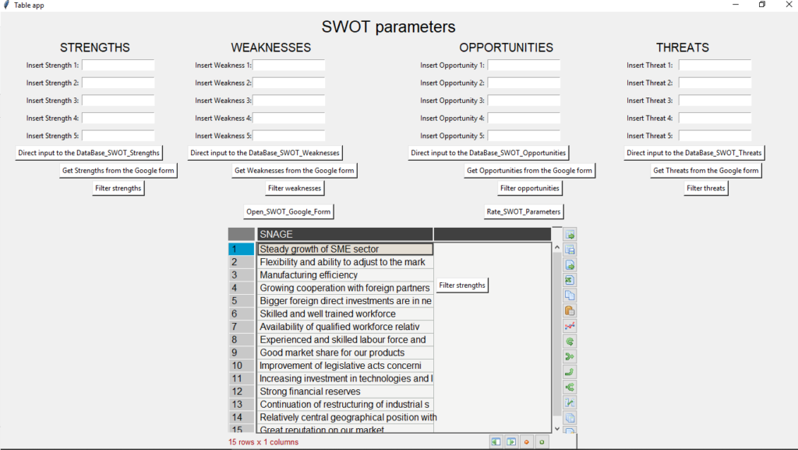
Project results: Identifying the needs, possibilities, and barriers for digitalization and Industry 4.0 concepts implementation in the SMEs in V4 and Serbia
Source: https://mksm.sjm06.com/visegrad-project-2021-possibilities-and-barriers-for-industry-4-0-implementation-in-smes-in-v4-countries-and-serbia/

Slide 36
Question 2
For selected Company (CSR) of SME (SE) develop SWOT matrix, and give the proposal for the Strategies / TOWS
Acknowledgement: This study is resulting from the international project: "Possibilities and barriers for Industry 4.0 implementation in SMEs in V4 countries and Serbia", which was financed through International Visegrad Fund, with the reference number: 22110036.

Slide 37
Business Model Canvas
The Business Model Canvas (BMC) is a strategic management tool to quickly and easily define and communicate a business idea or concept.
It is a one page document which works through the fundamental elements of a business or product, structuring an idea in a coherent way.
Alexander Osterwalder's canvas has nine boxes: customer segments, value propositions, channels, customer relationships, revenue streams, key resources, key activities, key partnerships, and cost structure.
Source: Osterwalder, Alexander (2004). The Business Model Ontology: A Proposition In A Design Science Approach (PDF) (Ph.D. thesis). Lausanne: University of Lausanne. OCLC 717647749. See also: Osterwalder, Alexander; Pigneur, Yves; Tucci, Christopher L. (2005). "Clarifying business models: origins, present, and future of the concept". Communications of the Association for Information Systems. 16 (1): 1. doi:10.17705/1CAIS.01601.

Slide 39
Question 3
For selected Company (CSR) of SME (SE) complete the BMC matrix.
https://miro.com/app/board/uXjVO9aimmQ=/

