Slide 1
Possibilities and barriers for Industry 4.0 implementation in SMEs in V4 countries and Serbia
Óbuda University – Keleti Faculty of Business and Management , Management, Enterprise and Benchmarking (MEB)
29-30 April, 2022
Budapest, Hungary
Ivan Mihajlovic
University of Belgrade, Technical Faculty in Bor
Vojske Jugoslavije 12, 19210 Bor, Serbia
www.menadzment.tfbor.bg.ac.rs
imihajlovic@tfbor.bg.ac.rs

Slide 2
Abstract
Acknowledgement: This study is resulting from the international project: "Possibilities and barriers for Industry 4.0 implementation in SMEs in V4 countries and Serbia", which was financed through International Visegrad Fund, with the reference number: 22110036.
In this study, the main results of the project will be discussed, which are International Monograph, published by the authors from the project consortium, special issue of Serbian Journal of Management, dedicated to the topic of Industry 4.0 and one software application, created during the project, which can be used for the SWOT analysis of small and medium sized enterprises.
Some important conclusions, regarding the possibilities to increase level of digitalisation of the SMEs sector in V4 countries and Serbia, will be discussed in the final segment of the study.

Slide 3
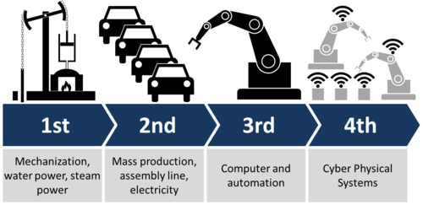
About the project
Modern technologies based on Industry4.0 change the business environment, especially in SMEs.
This opens a new field in research and possibilities for continuing and strengthening academic collaboration among partner institutions in Visegrad countries (V4) and Serbia which the focus would be on acceptance of Industry4.0 concepts in SMEs.
Source of Ilustration: https://www.psu.edu/news/research/story/manufacturing-vp-discuss-internet-manufacturing/

Slide 4
Project scope
In the previous project cycle (2018-2019) another research project was completed, focusing on the factors influencing SME failure and possibility of their recovery in Visegrad countries (V4) and Serbia: https://mksm.sjm06.com/visegrad-project-2018/
Based on the obtained results, it was concluded that one of the most significant factor that cause SME failure is the lack of knowledge and experience in the process of digitalization, e.g. implementation of ICT technologies.
This indicated that the avaliable tools based on the Industry4.0 can be the choice to improve this situation in SME business.

Slide 5
Project partners
Partners: Official V4 partners that participated in the project activities and the events are:
Óbuda University, Keleti Faculty of Business and Management – Hungary; web-page of the partner institution: http://uni-obuda.hu
University of Ss. Cyril and Methodius in Trnava; web-page of the partner institution: http://www.ucm.sk
Tomas Bata University in Zlin – Czech Republic ; web-page of the partner institution: www.utb.cz
University of Economics in Katowice – Poland; web-page of the partner institution: http://www.ue.katowice.pl/
Univeersity of Belgrade, Technical faculty in Bor: https://www.tfbor.bg.ac.rs/
Implementation period of the project: 01/06/2021–01/05/2022

Slide 6
Project activities
Identifying the needs, possibilities, and barriers for digitalization and Industry 4.0 concepts implementation in the SMEs in V4 and Serbia;
Developing the integrated methodological approach that will be applied in practice;
Publishing the special issue of Serbian Journal of Management dedicated to the project results;
Designing a business software solution for strategic decision-making in accordance with the available open source concepts of Industry 4.0;
Publishing one Monograpgh with the results obtained during the project research;
Introducing a special field of Industry 4.0 applications within the existing accreditated courses in the curriculum of the Technical Faculty in Bor, Department of Management.

Slide 7
Project results: Identifying the needs, possibilities, and barriers for digitalization and Industry 4.0 concepts implementation in the SMEs in V4 and Serbia
Researchers prepared the questionnaire form and the hypothetical research framework (model), based on which the survey was conducted among the owners, entrepreneurs and their employees. The survey was placed on the Google form: https://docs.google.com/forms/d/e/1FAIpQLSfxysCGc6qg9X9yfmmv2MPMMgqjUmhuyk-CLmDoi8f5cZqy5A/viewform

Slide 8
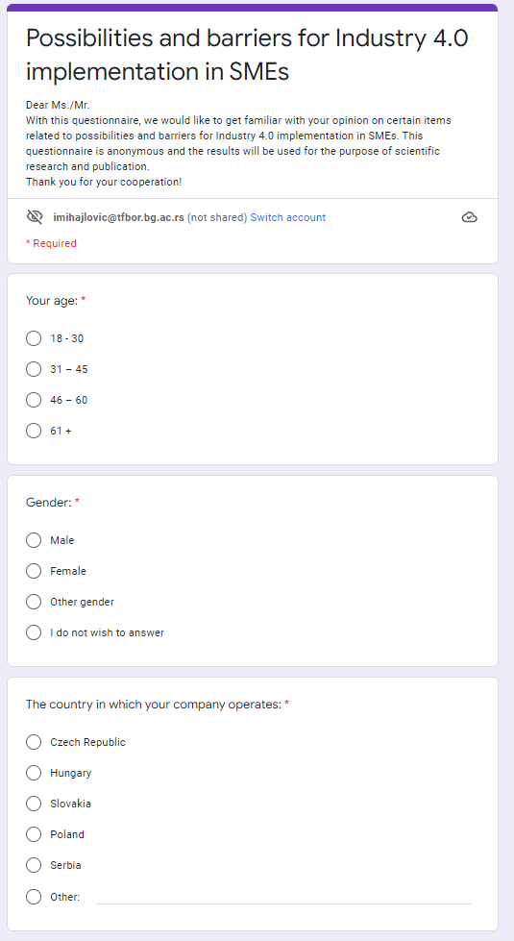
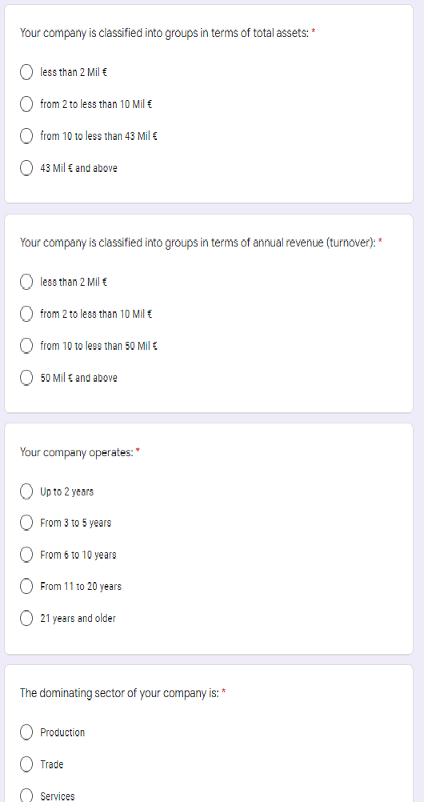
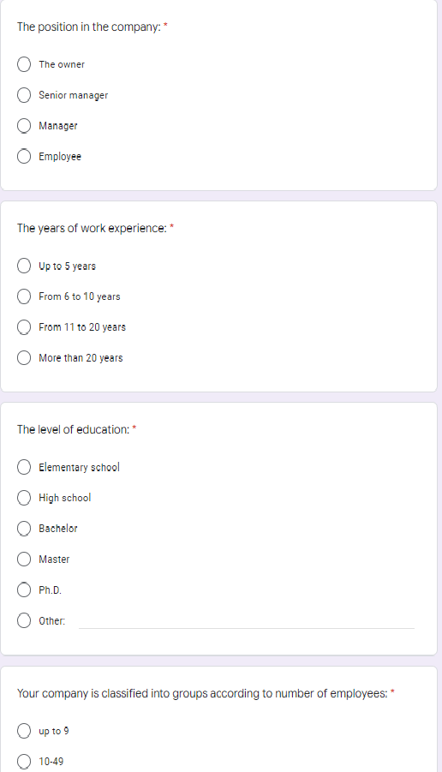
Project results: Identifying the needs, possibilities, and barriers for digitalization and Industry 4.0 concepts implementation in the SMEs in V4 and Serbia

Slide 9
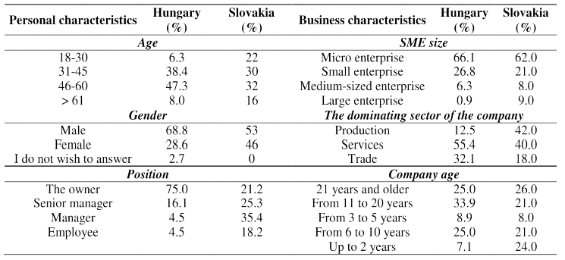
Project results: Identifying the needs, possibilities, and barriers for digitalization and Industry 4.0 concepts implementation in the SMEs in V4 and Serbia
Demographic profile of respondents and SMEs in Hungary and in Slovakia(nHU=112; nSK=100)
Source: Reka Saary, Judit Karpati-Daroczi, Andrea Tick, Serbian Journal of Management 17 (1) (2022) 33 - 49, https://aseestant.ceon.rs/index.php/sjm/article/view/36437/19909

Slide 10
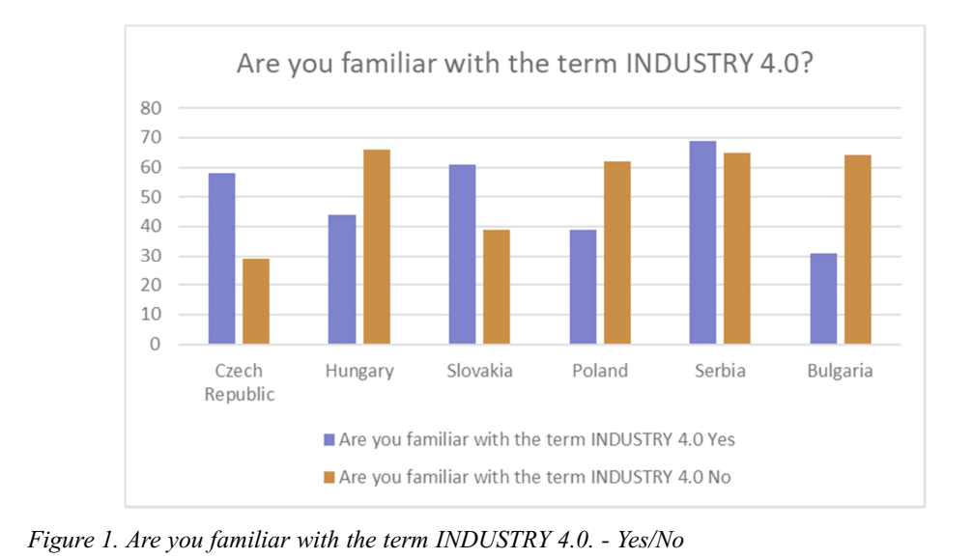
Project results: Identifying the needs, possibilities, and barriers for digitalization and Industry 4.0 concepts implementation in the SMEs in V4 and Serbia
Source: Anna Zaušová, Alena Kusá Michal Kubovics, Simona Ščepková and Renáta Miklenčičová , Serbian Journal of Management 17 (1) (2022) 253 - 264, ttps://aseestant.ceon.rs/index.php/sjm/article/view/36472/20060

Slide 11
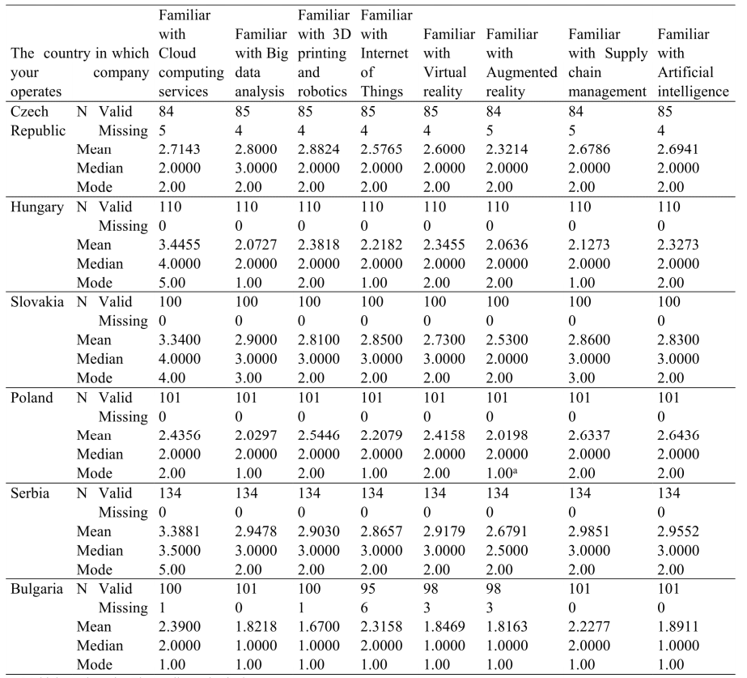
Project results: Identifying the needs, possibilities, and barriers for digitalization and Industry 4.0 concepts implementation in the SMEs in V4 and Serbia
Source: Anna Zaušová, Alena Kusá Michal Kubovics, Simona Ščepková and Renáta Miklenčičová , Serbian Journal of Management 17 (1) (2022) 253 - 264, https://aseestant.ceon.rs/index.php/sjm/article/view/36472/20060

Slide 12
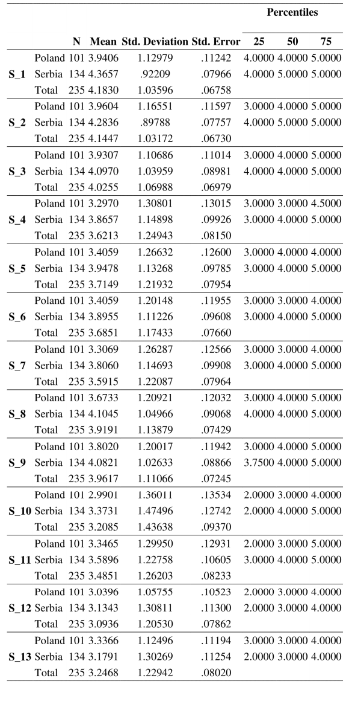
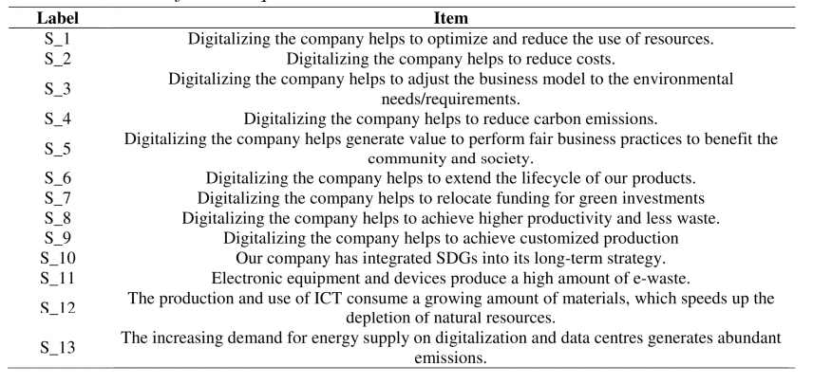
Project results:
Identifying the needs, possibilities, and barriers for digitalization and Industry 4.0 concepts implementation in the SMEs in V4 and Serbia
Source: Danijela Voza, Aleksandra Szewieczek and Dariusz Grabar, Serbian Journal of Management 17 (1) (2022) 15 - 31, https://aseestant.ceon.rs/index.php/sjm/article/view/36447/19866

Slide 13
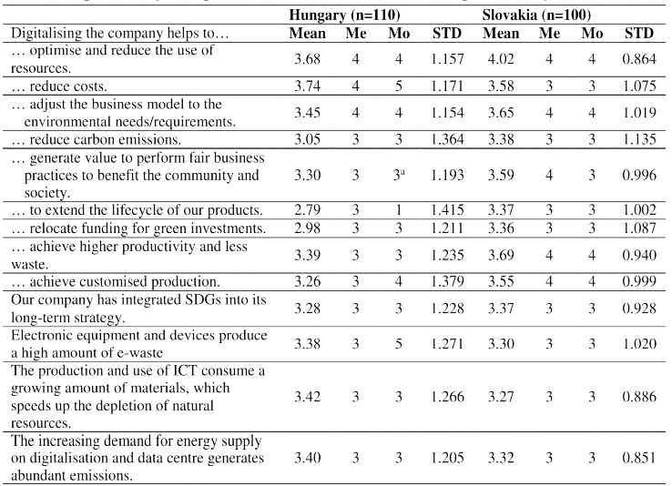
Project results: Identifying the needs, possibilities, and barriers for digitalization and Industry 4.0 concepts implementation in the SMEs in V4 and Serbia
Comparison of Hungarian and Slovakian SMEs on digitainability
Source: Reka Saary, Judit Karpati-Daroczi, Andrea Tick, Serbian Journal of Management 17 (1) (2022) 33 - 49, https://aseestant.ceon.rs/index.php/sjm/article/view/36437/19909

Slide 14
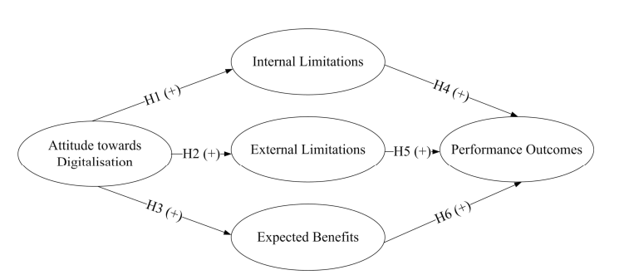
Project results: Developing the integrated methodological approach that will be applied in practice
H1: “Attitude toward Digitalisation” is related to “Internal Limitations””in Industry 4.0 context
H2: “Attitude toward Digitalization” is related to “External Limitations””in Industry 4.0 context
H3: “Attitude toward Digitalization” is related to “Expected Benefits””in Industry 4.0 context
H4: “Internal Limitations”of digitalization impact company ”Performance Outcomes” in Industry 4.0 context
H5: “External Limitations” of digitalization impact company “Performance Outcomes” in Industry 4.0 context
Source: Isidora Milošević, Sanela Arsić, Maja Glogovac, Ana Rakić and Jelena Ruso, Serbian Journal of Management 17 (1) (2022) 85 - 98, https://aseestant.ceon.rs/index.php/sjm/article/view/36413/19913

Slide 15
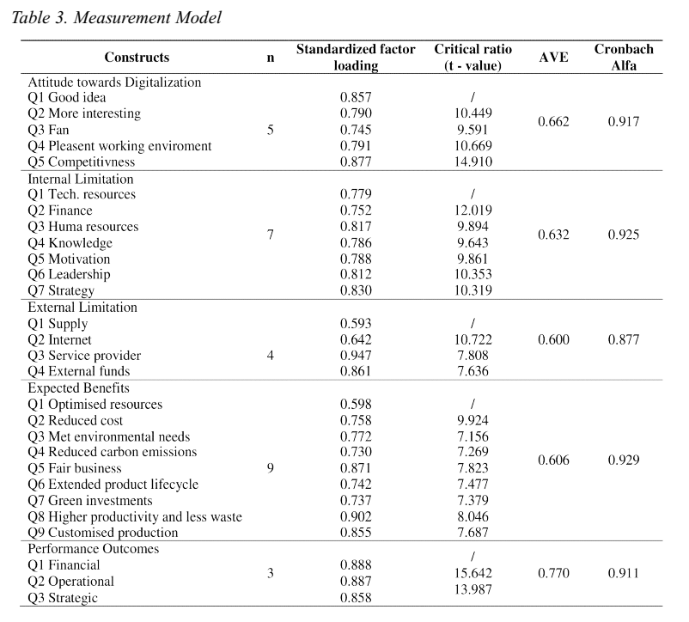
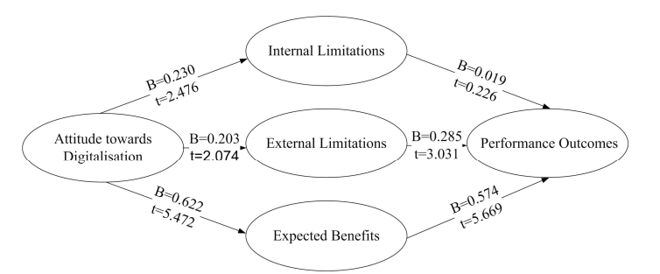
Project results: Developing the integrated methodological approach that will be applied in practice
Source: Isidora Milošević, Sanela Arsić, Maja Glogovac, Ana Rakić and Jelena Ruso, Serbian Journal of Management 17 (1) (2022) 85 - 98, https://aseestant.ceon.rs/index.php/sjm/article/view/36413/19913

Slide 16
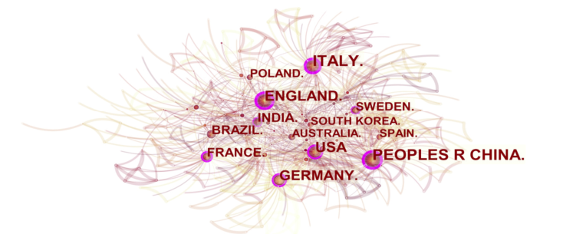
Project results: Developing the integrated methodological approach that will be applied in practice
Visualized network map of the country analysis
Source: Anđelka Stojanović, Serbian Journal of Management 17 (1) (2022) 125 - 143, https://aseestant.ceon.rs/index.php/sjm/article/view/36500/19922

Slide 17
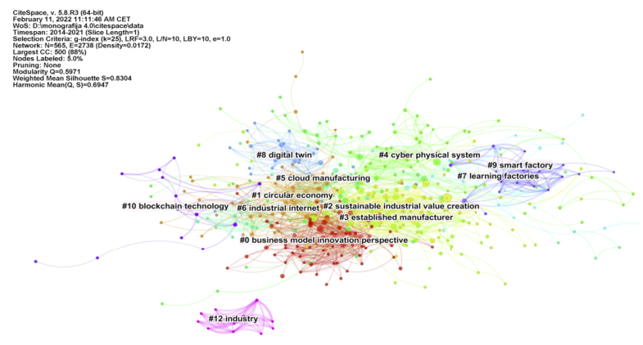
Project results: Developing the integrated methodological approach that will be applied in practice
Keyword clustering of the literature on Industry 4.0
Source: Anđelka Stojanović, Serbian Journal of Management 17 (1) (2022) 125 - 143, https://aseestant.ceon.rs/index.php/sjm/article/view/36500/19922

Slide 18
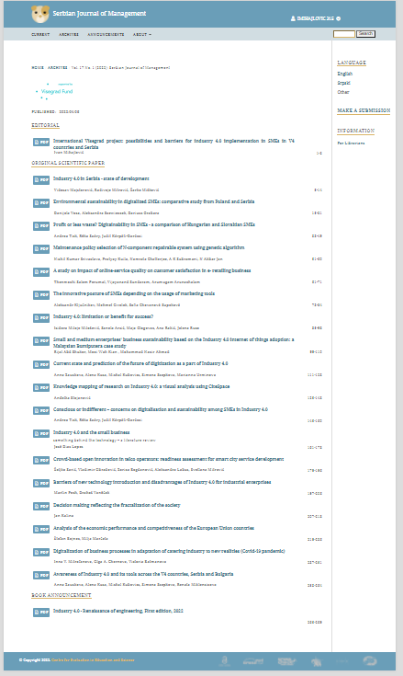
Project results:
Publishing the special issue of Serbian Journal of Management dedicated to the project results
Serbian Journal of Management is an international medium for the publication of work on the theory and practice of management science.
The journal is abstracted and covered by Scopus, Ebsco, Clarivate emerging sources citation index and many other source collecting bases. Its Scopus SCImago IF is 0.23, with the SJR category Q3.
The special issue of Serbian Journal of Management (www.sjm06.com ) 17(1)2022 is dedicated to the project “Possibilities and barriers for Industry 4.0 implementation in SMEs in V4 countries and Serbia”.
Source: https://aseestant.ceon.rs/index.php/sjm/issue/view/1324

Slide 19
Project results: Designing a business software solution for strategic decision-making in accordance with the available open source concepts of Industry 4.0
During the project, the pilot version of the software application was developed through the project activities, which can be applied in the SMEs business for obtaining the competitive advantages and long-term sustainability.
The software application is based on the platform, which can be used to collect the strengths, weaknesses, opportunities and threats, collected during interviews with entrepreneurs and placed in the google drive online database.
The entrepreneurs who use the application, can than directly insert their own SWOT parameters of their SMEs and rate them. As the outcome of this application, it is possible to compare the results of their own SWOT analysis, with average ranges of the SWOT parameters, collected in the online database.
Source: https://mksm.sjm06.com/visegrad-project-2021-possibilities-and-barriers-for-industry-4-0-implementation-in-smes-in-v4-countries-and-serbia/

Slide 20
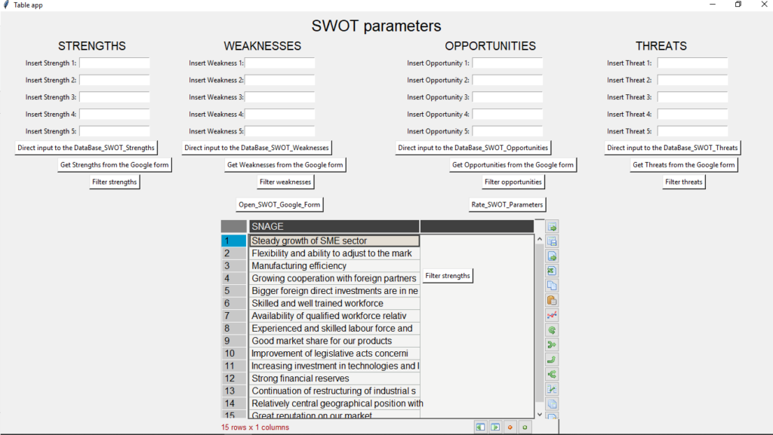
Project results: Designing a business software solution for strategic decision-making in accordance with the available open source concepts of Industry 4.0
Source: https://mksm.sjm06.com/visegrad-project-2021-possibilities-and-barriers-for-industry-4-0-implementation-in-smes-in-v4-countries-and-serbia/

Slide 21
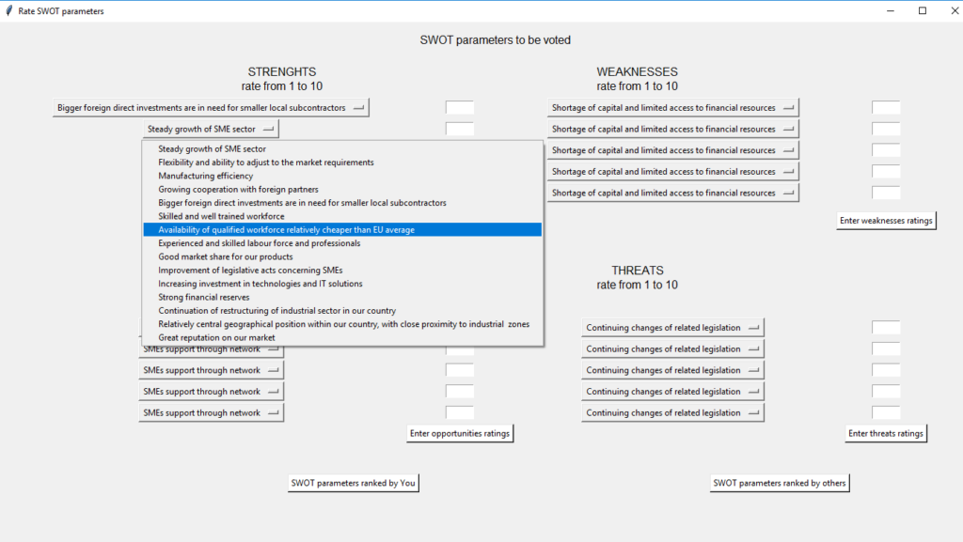
Project results: Designing a business software solution for strategic decision-making in accordance with the available open source concepts of Industry 4.0
Source: https://mksm.sjm06.com/visegrad-project-2021-possibilities-and-barriers-for-industry-4-0-implementation-in-smes-in-v4-countries-and-serbia/

Slide 22
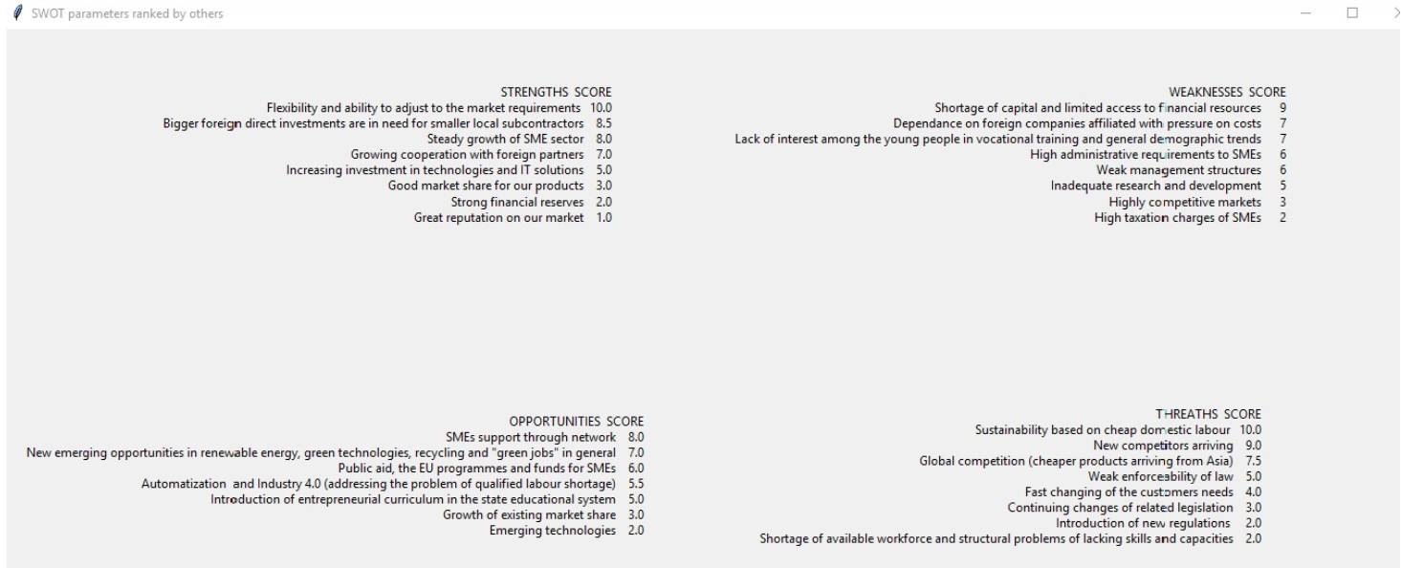
Project results: Designing a business software solution for strategic decision-making in accordance with the available open source concepts of Industry 4.0

Slide 23
Project results: Designing a business software solution for strategic decision-making in accordance with the available open source concepts of Industry 4.0
The software application was coded in Python programming environment, using the available packages for the AI, cognitive computing and big data modelling of the cloud stored data - located in Google drive and Google forms.
The entire code will soon be available at GitHub: https://github.com/imihajlovicBor/SWOT

